Slide 1


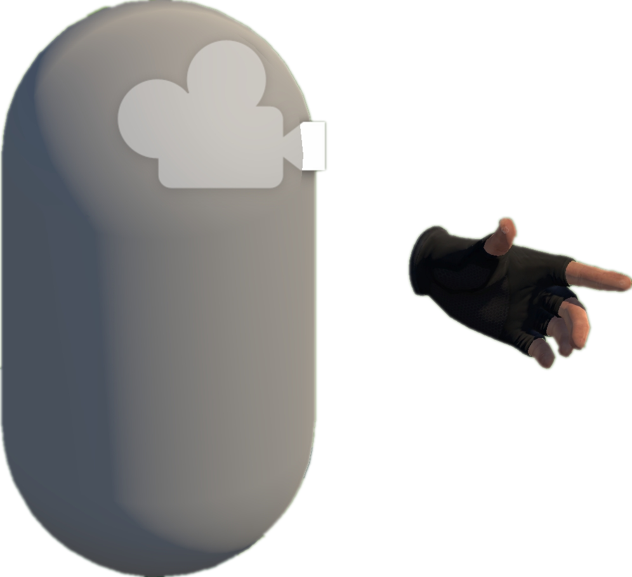







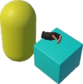
A
Project Collection (§3.2)
E
VRExplorer Test (§3.5)
Behavior Execution and Scene Exploration
3
Preliminary Scene Configuration
Open Source
Repositories
Tags & Topics
1
Camera
Unity-based
Projects
Bake NavMesh
Scene with NavMesh (facilitates agent navigation in the Unity scene)
Hand Controller
Original Scene
Collider
High-Quality Unity VR Projects
Manifest Validation
& Manual Check
VRExplorer Agent
Implementation Interface
Interaction & Scene Analysis
All Scripts
2
Customizing Entity Interface Configuration
PFSM
Autonomous Event Invocation
Project Analysis (§3.2)
Core Scripts
B
Decision Making
Task Execution
Hierarchy Analysis
Game Logic Code & Third Plugin Analysis
Scripts Implemented
Entity Interface
Task Execution
Autonomous
Event Invocation
Environment
Interactables
Box
Input Next
Interactable’s Mono
EAT Framework (§3.4)
Output
Task
Model
D
Task Generator
Model Abstraction (§3.3)
Task Generator & Customized Task Model
C
Example Task Model
Parallel and serial combinations
Abstraction Object Interaction Feature
Grab-And-Drag-Box Task
Triggerable
Base Action
Move to Approcach
Parallel Action
Inherit
Button, Joystick
Triggerable & Grabbable
Grab Action
Trigger Action
Grab
Move Action
Grab Action
Gun, Cigarette Lighter
Move Action
Grabbable
Box, Coin
Grab
Base Entity
Trigger
Walk Around
Asynchronous Action
Inherit
Abstraction Action
Press
Pressing
Trigger Action
+ Triggering Time
+ Triggering() + Triggered()
Grabbable Entity
Triggerable Entity
Pressed
Task Layer
Entity Interface
C# Scripts File
Pull
Pulling
Action Layer
Relaxed
Unity Scene
GameObjects
Fire
Pulling the trigger
Implement
Entity Layer
Triggered
XR Box
XR Joystick
XR Button
Mono Scripts
Third Plugin / Package
Notes:
单击此处添加文本

